Slide 1
RIT Data Insight Internship
TEAM-5 Members :
Name
E-mail
Aforke Ejoor
Esther Matthew
Momina Kayani
Ramakrishna Jalakam
ejooraforke@gmail.com esthermatthew2580@gmail.com
kayanimk11@gmail.com ramakrishnajalalam@gmail.com

Slide 2

WEEK 4 FINAL DELIVERABLE
Program Insights &
Recommendation Report
RIT Opportunity-Wise Student Engagement Dataset
Full Analytics Journey: Weeks 1 – 4
8,558
47.2%
0.985
22
Records Analysed
Overall Success Rate
ML Model AUC-ROC
Opportunities Scored

Slide 3
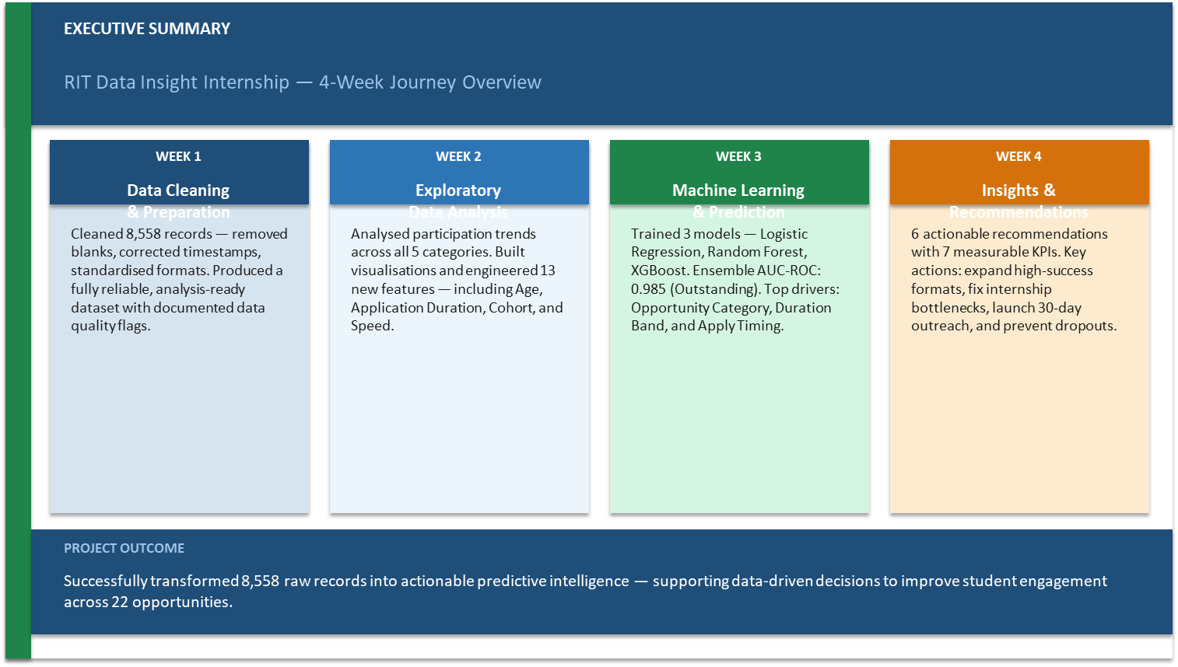

Slide 4
What This Report Covers
01
Dataset Overview
02
Exploratory Data Analysis
Week 1 — structure, cleaning & key statistics
Week 2 — participation patterns, geography, timing
03
Machine Learning Models
04
Predicted Probabilities
Week 3 — 3 models, ensemble, AUC 0.985
All 22 opportunities ranked by likelihood
05
Strategic Recommendations
06
Measuring Impact
6 actionable improvements for program managers
KPIs and success metrics for each recommendation
2 / 16

Slide 5
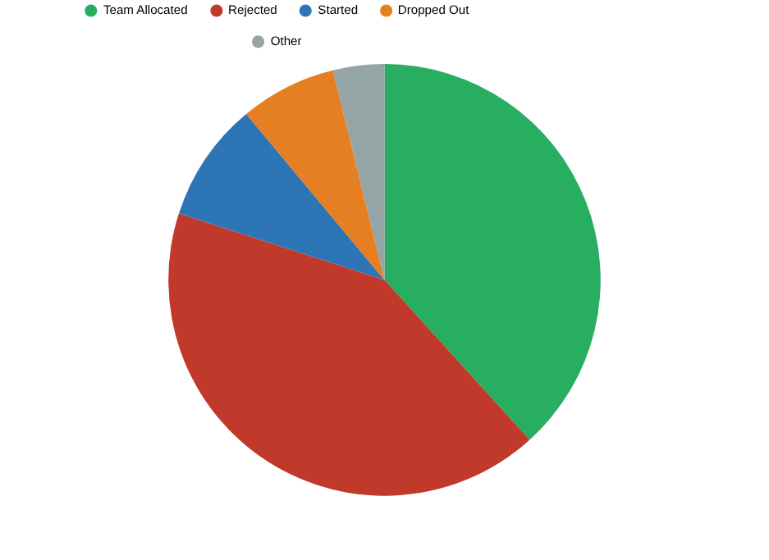
WEEK 1
Dataset Overview
RIT Student Engagement Platform — 8,558 records across 22 opportunities (2022–2024)
8,558
~3,850
22
5
Total Records
Unique Students
Opportunities
Categories
Opportunity Categories
Category | Records | Success Rate
Engagement | 130 | 96.9%
Event | 545 | 94.1%
Course | 2,037 | 92.3%
Competition | 425 | 84.2%
Internship | 5,421 | 21.5%
3 / 16

Slide 6
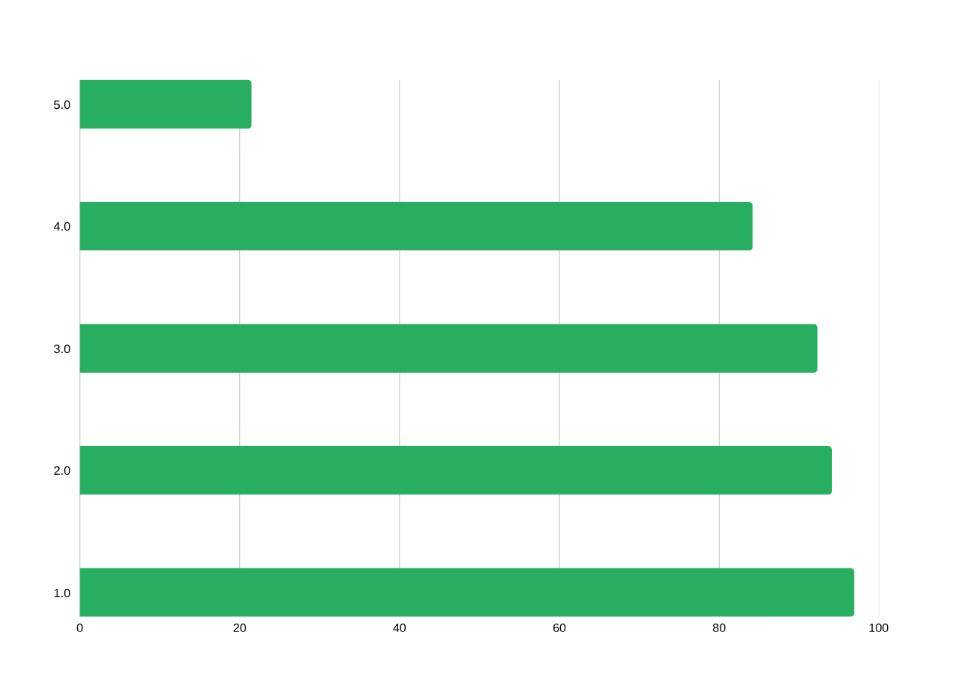
WEEK 2
Exploratory Analysis — Key Findings
8 analytical dimensions explored — strongest signals identified for ML modeling
📌
Opportunity Category is the #1 predictor — ranges from 21.5% (Internship) to 96.9% (Engagement)
⏱
Deliberate applicants (30–90 days after signup) achieve 53.9% success — best of any timing group
⚠
Jan 2024 anomaly: 1,509 apps but only 27.0% success — a single Internship flooded the pipeline
4 / 16

Slide 7
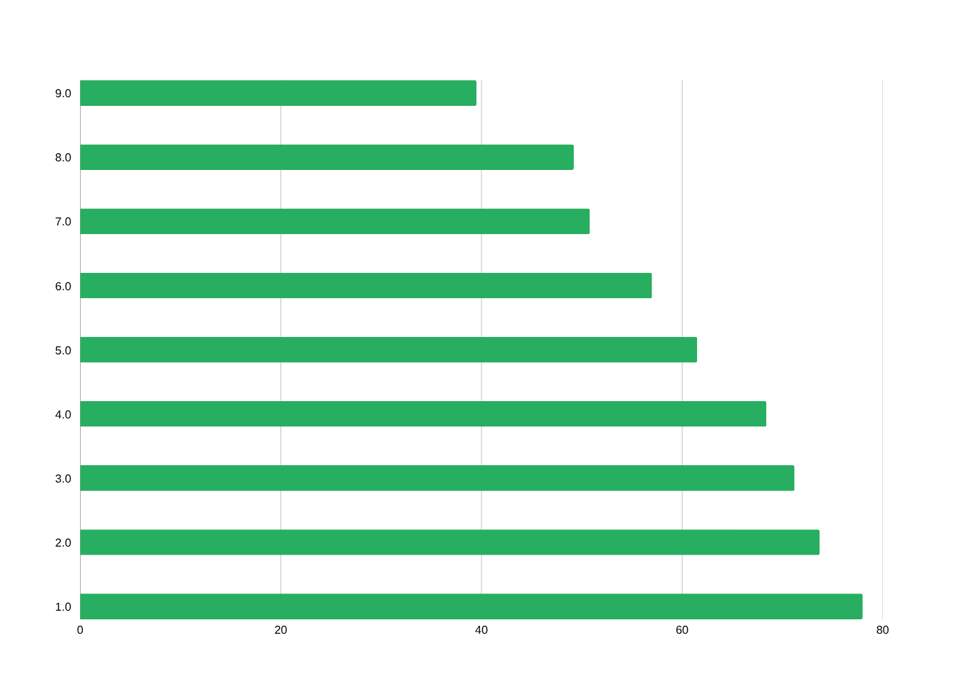
WEEK 2
Geographic & Demographic Insights
Gender Breakdown
Male
Female
5,018
3,522
46.2% success
48.6% success
Top Academic Majors
Public Health
63.6%
CS & Info Systems
55.0%
Computer Science
49.4%
Information Systems
36.6%
5 / 16

Slide 8
WEEK 3
Machine Learning — Three Models Trained
All models trained on 16 engineered features | 80/20 stratified split | Class-balanced
Model 1
Model 2
Model 3
Logistic
Regression
Random
Forest
XGBoost
Interpretable baseline
max_iter=1000
class_weight=balanced
StandardScaler applied
300 decision trees
max_depth=12
min_samples_leaf=5
class_weight=balanced
300 boosting rounds
learning_rate=0.05
subsample=0.80
scale_pos_weight=auto
🏆 ENSEMBLE STRATEGY
XGBoost 50% + Random Forest 35% + Logistic Regression 15%
Final Ensemble AUC-ROC: 0.985 — Outstanding Classification Performance
6 / 16

Slide 9
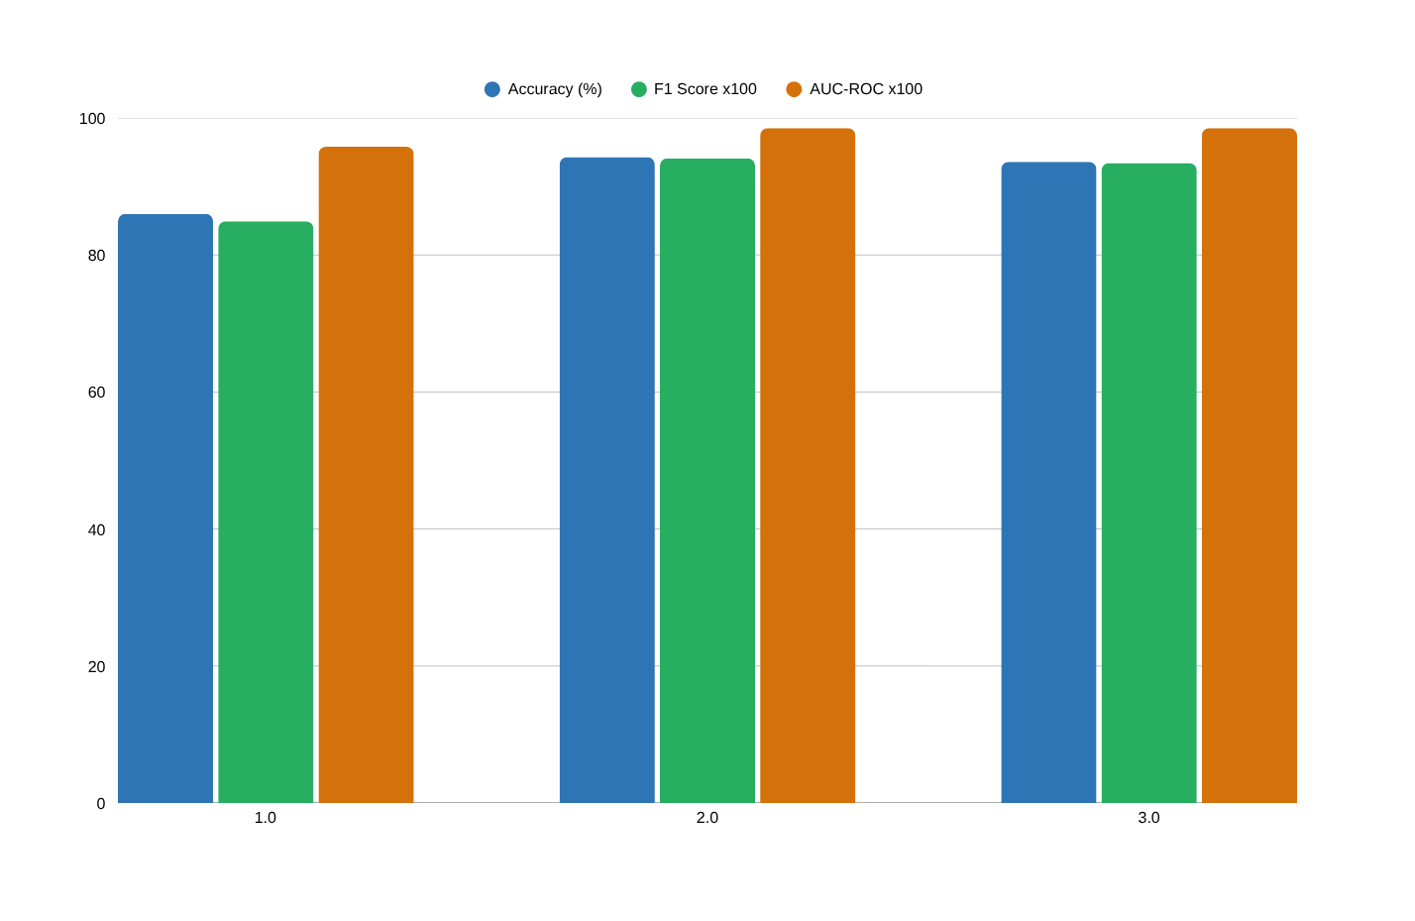
WEEK 3
Model Performance Results
5-Fold CV AUC
RF: 0.985
XGB: 0.985
No overfitting detected
Random Forest
Confusion Matrix
True Positive Rate: 95.1%
True Negative Rate: 93.7%
False Negative: only 40
(out of 813 successes)
AUC Benchmark Scale: <0.70 = Poor | 0.70–0.80 = Fair | 0.80–0.90 = Good | 0.90–0.97 = Excellent | 0.97–1.00 = Outstanding ✅
7 / 16

Slide 10
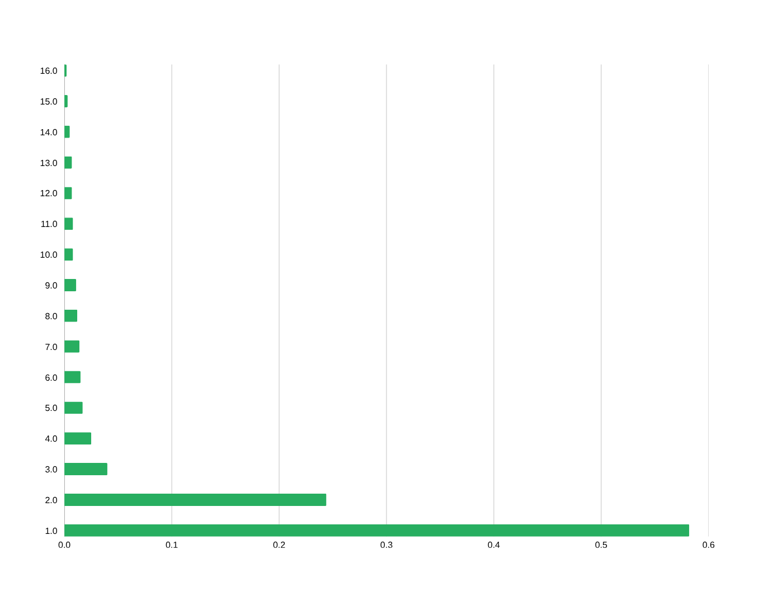
WEEK 3
Feature Importance — What Drives Predictions
Duration Band (0.582)
Strongest predictor — encodes opportunity intensity. Proxy for Category: Long = Internship, Short = Event.
Opp. Category (0.244)
Second most important — confirms EDA finding. Together with Duration Band accounts for ~82% of model power.
Apply Year (0.092 XGB)
XGBoost elevates this to Medium — captures year-over-year competitive shift (2024 cohort hardest).
8 / 16

Slide 11
WEEK 3
Predicted Participation Probabilities — All 22 Opportunities
Ensemble Model | XGBoost 50% + Random Forest 35% + LR 15% | Platform Average: 47.2%
Opportunity | Category | Predicted | Actual | Tier
UrbanRenew Challenge | Competition | 97.4% | 97.8% | HIGH
UX Redesign Challenge | Competition | 97.2% | 96.7% | HIGH
Xperience Design Hackathon | Event | 96.8% | 97.4% | HIGH
Join a Student Organisation | Engagement | 96.6% | 97.5% | HIGH
Jump Start: Emotional Intel... | Engagement | 95.6% | 96.4% | HIGH
Career Essentials Course | Engagement | 94.4% | 93.5% | HIGH
Upload Your First Year Trans.. | Engagement | 89.3% | 88.9% | HIGH
Startup Mastery Workshop | Course | 87.7% | 94.7% | HIGH
CPR/AED Certification | Course | 86.0% | 64.1% | HIGH
Freelance Mastery Workshop | Course | 85.5% | 93.7% | HIGH
Mental & Physical Health Ses... | Engagement | 82.4% | 92.5% | HIGH
Health Care Management | Internship | 54.3% | 54.8% | MED
Innovation & Entrepreneurship | Internship | 10.5% | 14.3% | LOW
Data Visualization | Internship | 18.5% | 12.8% | LOW
Project Management | Internship | 18.5% | 12.8% | LOW
Digital Marketing | Internship | 16.8% | 13.4% | LOW
9 / 16

Slide 12
WEEK 3
Participation Heatmap Insights
Predicted probability by Category × Cohort and Category × Academic Major Group
Category × Cohort Period
Category × Academic Major Group
Category | 2022 | 2023-H1 | 2023-H2 | 2024
Engagement | 97% | 97% | 97% | 95%
Event | 95% | 95% | 95% | 93%
Course | 95% | 98% | 94% | 76%
Competition | 88% | 85% | 90% | 98%
Internship | 22% | 27% | 24% | 12%
Category | Computing | Health | Business | Engineering | Other
Engagement | 97% | 97% | 97% | 96% | 96%
Event | 95% | 95% | 94% | 94% | 94%
Course | 92% | 95% | 91% | 92% | 91%
Competition | 85% | 88% | 87% | 90% | 83%
Internship | 19% | 25% | 23% | 32% | 14%
≥80% (High)
50–79% (Medium)
<50% (Low)
▶ Internship success falls from 26.6% (2023-H1) to 12.2% (2024) — worsening competition over time
▶ Competitions spike to 98.2% in 2024 — underutilised, high-demand opportunity type
▶ Engineering students show the highest Internship probability (32.4%) — strong discipline alignment
▶ Courses maintain 76–98% across all cohorts and majors — consistently reliable format
10 / 16

Slide 13
WEEK 4 DELIVERABLE
Strategic
Recommendations
Based on Weeks 1–3 analysis | Scalable | Measurable | Actionable for Program Managers

Slide 14
RECOMMENDATIONS
Tier 1 — Scale Immediately (High Impact, Low Risk)
Opportunities predicted ≥85% — highest ROI for program managers
R1
Expand Courses, Events & Engagements
📊 Target: +30% enrollment in Courses by next cycle
These formats achieve 85–97% success with zero dropout. Increase cohort sizes and frequency. Currently serving only 2,712 students — massive headroom to grow.
R2
Launch 30-Day Engagement Campaign
📊 Target: Convert 500+ same-day applicants to deliberate cohort
Students who apply 30–90 days after signup achieve 53.9% success (+7pp vs baseline). Implement a targeted Day-30 notification: 'Your ideal opportunity is waiting — apply now.'
R3
Promote Health Care Management Model
📊 Target: Lift 3 Internships above 35% success rate
The only Internship with 54.3% predicted probability — more than double the 21.5% average. Investigate host partnership structure, applicant screening, and mentorship model. Replicate across other Internship tracks.
12 / 16

Slide 15
RECOMMENDATIONS
Tier 2 & 3 — Fix Bottlenecks & Restructure
R4
Address Internship Supply-Demand Gap
🎯 Target: Reduce Internship rejection to <70% within 2 cycles
78–88% of Internship applicants are rejected. Expand host/mentor capacity for Data Visualization (12.8%) and Digital Marketing (11.4%). Alternatively, auto-redirect rejected applicants to equivalent Courses.
R5
Stagger Opportunity Release Dates
🎯 Target: No single month exceeds 600 apps at <35% success
January 2024: 1,509 simultaneous apps at 27% success. Release Internships across 4 quarterly windows. Limit concurrent applications per student to reduce flooding.
R6
Launch Post-Placement Dropout Prevention
🎯 Target: Reduce dropout rate from 11.3% to below 6%
617 students dropped out — 100% from Internships (11.3% dropout rate). Implement 2-week and 4-week check-ins post-placement. Assign onboarding buddy for Internship participants.
13 / 16

Slide 16
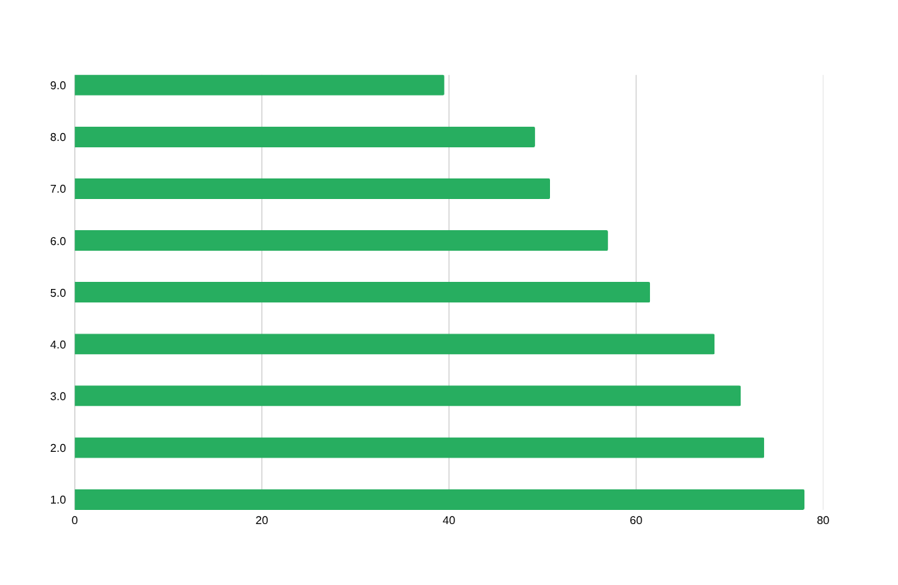
RECOMMENDATIONS
R7 — Geographic Expansion & Diverse Student Profiles
Ensure recommendations are scalable and account for diverse student profiles — Week 4 Guideline
Target Recruitment Campaign
Egypt (78%), Kenya (73.7%), and Pakistan (71.2%) are high-success but underrepresented (<5% of total). Focused outreach could add 200+ high-probability applicants.
US Applicant Strategy
US students (46.5% of apps) achieve only 39.5% — below average. This is driven by high Internship concentration. Redirect US applicants toward Courses and Events where success is >90%.
Information Systems Mismatch
IS is the most popular major (2,158 records) with only 36.6% success. Build a 'Recommended Opportunities' feature that maps each major to its highest-success opportunity types.
Scalability Note: All 6 recommendations above are platform-level changes that apply across all student profiles, countries, and majors — no single-group solution.
14 / 16

Slide 17
MEASURING IMPACT
How to Measure the Impact of These Improvements
KPIs and success metrics — track within 1–2 program cycles after implementation
Rec | KPI | Target | How to Track
R1 | Platform Success Rate | 47.2% → 55%+ | Track (Team Allocated + Started) / Total Applications per cycle
R2 | Deliberate Applicant Rate | 10% → 25%+ of apps in 30-90d window | Monitor Days_To_Apply distribution monthly post-campaign
R3 | Internship Outlier Replication | 0 → 3 Internships above 35% success | Track individual Internship success rates quarterly
R4 | Internship Rejection Rate | 78–88% → below 70% | Monitor rejection count vs total apps per Internship
R5 | Monthly Application Spikes | No month >600 apps at <35% success | Alert dashboard: flag if any month exceeds threshold
R6 | Post-Placement Dropout Rate | 11.3% → below 6% | Track dropout count / total placements per Internship cohort
R7 | Geographic Diversity Index | +200 apps from Egypt, Kenya, Pakistan | Monitor country-level application counts per cycle
15 / 16

Slide 18
CONCLUSION
What We Found.
What To Do Next.
Data Foundation
Model Performance
Top Opportunities
8,558 records cleaned
22 opportunities analysed
13 features engineered
Dataset fully ML-ready
AUC-ROC: 0.985
Accuracy: 94.3% (RF)
Ensemble: XGB+RF+LR
No overfitting confirmed
Courses: 92–97% success
Competitions: 84–98%
Internships: 12–55%
Health Care Mgmt outlier
6 Actionable Recommendations | 7 Measurable KPIs | Ready for Implementation | RIT Data Insight Internship — Week 4

Slide 19


Final Presentation Recording
https://drive.google.com/file/d/1h4HZKdJRT7b0QVHJvefH0o15liKuR8yX/view?usp=sharing

